Slide 1
How to write a thesis
Research class: IFL 2020-2021
Moniroith Vann, PhD

Slide 2
A Thesis Structure
Title
Abstract
Introduction
Background
Literature Review
Research method Section
Results/ Findings Section
Findings Discussion
Conclusion
References
Appendixes

Slide 3

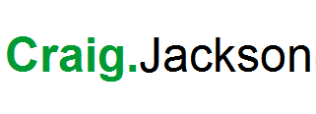
A thesis structure
Abstract
Introduction
Lit Review
Participants
Design
Tools used for collecting data
Method
Results
Discussion & Conclusion
References

Slide 4
Your thesis title
The title should be short and eye-catching as it gives the first impression to the reader.

Slide 5
Writing an abstract
The purpose of an abstract is to provide a complete overview of the study sufficient to inform the reader of the nature and the context of the study and its outcome.
Our aim is to create a short cut to the content of the document, encouraging the reader to read the whole thesis.

Slide 6
Chapter 1: Introduction
The aim is to encourage the reader to read your study.
Start by giving a background which allows the reader to understand the origin of the research issue more fully.
The background is usually built on a literature review from main authors
Description of the study and problems are written to intrigue the reader and designed to grab attention.
It is a mental road map for the reader.
It sums up the content of the document so that the reader can anticipate what is followed:
A statement of what the study is about and the focus of the inquiry.
Research questions and aims.
What you consider this study is important.
Describe the method briefly how data are collected and how they are managed, and analyzed.
The significance and the context of the study as you persuade the reader the study is a worthwhile contribution to knowledge.

Slide 7
Chapter 2: Literature Review

Slide 8
What is this presentation about?
What is a literature review?
How to write a good literature review!!!
Elements of a literature review
Basic steps on writing a literature review
Examples of a literature review

Slide 9
What is a literature review?
A literature review is an account of what has been published on a topic by scholars and researchers. The purpose of writing a literature review is to “convey our readers what knowledge and ideas have been published on a topic and what their strengths and weaknesses are”. (by Taylor retrieved from http://www.utoronto.ca/writing)

Slide 10
What is a Literature Review?
A “lit review” is the review of the research literature related to the problem or question posed?
Once the problem or question has been identified, information is needed about the problem so that it can be placed in the proper context and the research can proceed…

Slide 11
What is a literature?
The literature review is a distinctive form of research that generates knowledge about the topic reviewed. It is a form of research that reviews, critiques and synthesize representative literature on a topic in an integrated way that new frameworks and perspectives on the topic are generated.

Slide 12
What is a literature review?
A literature review can be just a summary of the resources, but it usually has an organization pattern and combines both the summary and synthesis. A summary is a recap of the information of the sources but a synthesis is a re-organization or reshuffle of that information. It might give a new interpretation of old material or combine new with old interpretations. The literature review may evaluate the sources and advise the reader on the most pertinent or relevant.

Slide 13
Elements of a literature review
Topics, issues, themes or sub-topics
Overview of issue, subjects relating to the issue, theory and research methodology.
Pros and cons on the topic and the author position.
Gaps identified from researching the topic

Slide 14
Basic steps on writing a literature review
Define a topic and sub-topics
Search sources
Read and annotate important ideas from sources
Organize annotations in a mind map or a table
Decide focus to write
Write the first draft
Revise the draft (you may ask peer/colleague to review it)
Write final paper and check formatting (referencing styles)

Slide 15
Define a topic and sub-topics
Example #1:
Topic: ESL reading skills
Sub-topics:
Characteristics of ESL leaners
Reading problems of ESL learners
Teaching reading for ESL learners
Technology and learning for ESL learners

Slide 16
Define a topic and sub-topics
Example #2
Topic: People living with HIV
Sub-topics
What are the public opinions about people living with HIV?
How to change stigma and misperception in public opinions about people with HIV?
Why people with HIV need support from families and friends?
How a support group can develop a positive thinking about people living with HIV?

Slide 17
Search the sources
School or public libraries
Google Scholar
References listed in previous research
Databases

Slide 18
Read and annotate important ideas from the sources
Phase 1: Skim and Scan
Use key words or phrases to locate on your search engines/database
Read tittles, abstracts or conclusions (journal articles) or table of content (books).
Phase 2: Read carefully
Go over the reading you chose from Phase 1
Use highlight or annotate ideas from the papers
Use note-taking techniques to annotate main ideas

Slide 19
Organize your annotation in a mind map or a table
Mind mapping
Word Processor has drawing tools that you can use to draw your ideas
Free mind mapping online tools from Google
Organize annotation in a table
Topic:………………..
No | Themes | Article 1 | Article 2 | Article 3
1
2

Slide 20
Decide focus to write
Based on your mind mapping table, you know what information you can get and what you cannot.
Maybe you consider deleting one or two of your sub-topics or you have to change the sub-topics
Consider how you want to organize your paper

Slide 21
Write your first draft
Remember that this is a first draft. It doesn’t have to be perfect
Start briefly introducing your ideas, topic, subtopics
Use sub-tittle for every sub topic that you write
Avoid using your own opinions in this paper (summarize, synthesize and criticize)

Slide 22
Revise Your Draft
After your first draft, let it down for a night or two
Revisit your draft and read it from beginning to end
Conduct a literature review search
While reading it, do some revisions and editing
Seek feedback from peers

Slide 23
Write the final paper and check formatting
Use your revised draft as the final paper
Write it based on requirements of submission
Refer to writing style or manual
Check citation styles or reference styles

Slide 24
Summary
A literature is a form of research
Topic and sub-topics are elements to determine writing a literature review
A good literature review can help scholars to answer their curiosity about problems in their field before doing field research

Slide 25
Research should be valid
Validity is when something should be based on fact or evidence
Internal validity is the extent to which results can be interpreted accurately
External validity is the extent to which results can be generalized to a population, situations and conditions..in action research we are not concerned about this area…

Slide 26
Research should be reliable
Reliability of research concerns the replicability and consistency of the methods, conditions, and results.
HW: Write a reflection on a literature review.

Slide 27

Chapter 3: Research Methodology Section
Writing a thesis

Slide 28
What is the purpose of this chapter?
To justify the researcher’s choice of methodology and method used to answer the research questions.
The reader needs to know why and how these decisions were made.
Primary authors need to be drawn to establish your credibility as a researcher and support your choices.
Methodology
Method
Data collection tool
Data analysis tool
Sample
Ethical and legal issues

Slide 29
Methodology section
A research methodology is a way of systematically solving the research problem and answering the research question (s).
It may be understood as a science of studying of how research is done scientifically.
Methodology is the study of how research is done, how we find out about things, and how knowledge is gained. In other words, methodology is about the principles that guide our research practices. Methodology therefore explains why we’re using certain methods or tools in our research.

Slide 30
Methodology (continued)
What is a research methodology?
It is the research design that shapes our choice and use of particular method and link them to the desired outcomes.
For example, action research, ethnography, grounded theory, phenomenology, historical research are methodologies.
What is a method?
It is a technique or procedure used to collect and analyze data related to some research questions or hypothesis (if you use a quantitative apporoach).
For example, interviews, surveys, observations.

Slide 31
Research methods
Describe your sampling and data collection procedures
Identify your instruments: interviewing, questionnaire, surveys, observations…
What about validity and reliability?
How will you analyze the data? Important to think about ahead of time, if you are using human subjects you need to go through an institutional review board.

Slide 32
Data Collection
Measuring instruments must be identified and/or developed
If the data is descriptive in nature, you must take field notes
You can collect data by doing interviews, observations, focus group discussions
If you conduct a survey, you need to determine what measuring instruments you will use, i.e. questionnaires, standardized tests
Think ahead about preparing the data you collect for analysis

Slide 33
Quantitative
A quantitative approach is one in which the investigator primarily uses post-positivist claims for developing knowledge (i.e. cause and effect thinking, reduction to specific variables and hypotheses and questions, use of measurement and observation, and the test of theories). (Creswell, 2003, p.19)

Slide 34
Quantitative
A quantitative approach is one in which the investigator primarily uses post-positivist claims for developing knowledge (i.e. cause and effect thinking, reduction to specific variables and hypotheses and questions, use of measurement and observation, and the test of theories). (Creswell, 2003, p.19)

Slide 35
Qualitative - Definition
A qualitative approach is one in which the inquirer often makes knowledge claims based primarily on constructivist perspectives (i.e. the multiple meanings of individual experiences, meanings socially and historically constructed, with an intent of developing a theory or pattern) or advocacy/participatory perspectives (i.e. political, issue-oriented, collaborative or change oriented) or both. (Creswell, 2003, p.18)

Slide 36
Data Analysis (C., p.191)
Organize and prepare the data for analysis
Read all data, get a sense of the whole
Begin detailed analysis with coding process
Generate a description of the setting/people as well as categories or themes for analysis
Represent themes (writing, visual, etc.)
Interpret and make meaning out of data

Slide 37

How do I summarize and make sense of all these words?
Chapter 4: Data analysis
Preparing for qualitative data analysis
Vann Moniroith, PhD
Pannastra University of Cambodia

Slide 38
How to present your data
We have already discussed how best to analyze data
The results of your data analysis tell you WHAT is happening in your study.
Your data are in pieces. You have to piece them together. It means you have to weave the threads and make them look interesting.

Slide 39
Qualitative or narrative data may come from…
Open-ended questions and written comments on questionnaires
Testimonials
Interviews
Focus groups
Logs, journals, diaries
Observations,
Documents, reports, news articles
Stories
Case studies

Slide 40

The narrative responses may be brief or very long and detailed.
Your job is to make sense of these data and to make them understandable for others.

Slide 41
Typical errors
Listing all narrative comments without doing any analysis.
Including information that makes it possible to identify the respondent.
Generalizing from comments to the whole group. Qualitative information seeks to provide unique insights, understanding and explanation – it is not to be generalized.
Using quotes to provide a positive spin. Consider your purpose for including quotes.

Slide 42
A common approach for analyzing qualitative data is called content analysis. It involves 5 steps:
Get to know your data
Focus the analysis
Categorize the information
    Identify themes or pattern
    Organize them into coherent categories
Identify patterns and connections within and between categories
Interpretation – bring it all together

Slide 43
Preparing for Data Analysis
Do these data answer my question? If so, how?
What are the main messages so far?
What are the gaps in the messages I need to fill?
Am I asking the right questions or are the data telling me that something else is more important?
Do I need other kinds of data to help me really see what I am looking for?
To answer my questions, are pieces of data more important than others?

Slide 44
Step 1. Get to know your data. Good qualitative data analysis depends upon understanding your data. Spend time getting to “know” your data.
Read and re-read the text
Listen to tape recordings if you have them; transcribe data
Check the quality of the data. Is it complete and understandable. It it likely to add meaning and value? Was it collected in an unbiased way?

Slide 45
Step 2. Focus the analysis
Review the purpose of the evaluation and what you wanted to find out.
Based on your ‘getting to know your data’, think about a few questions that you want your analysis to answer and write them down.
You might focus your analysis by question, topic, time period, event, individual or group.

Slide 46
Step 3. Categorize information
Some people call this process ‘coding’ the data.
It involves reading the data and giving labels or codes to the themes and ideas that you find.
You may have themes or ideas you search for (pre-set categories) and/or create categories (emergent categories) as you work with the data.

Slide 47
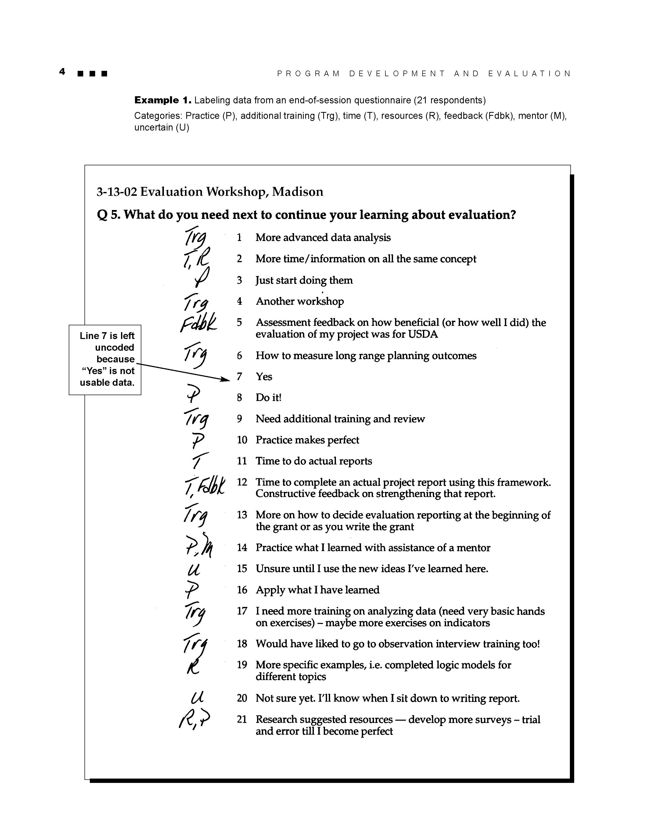
Example of categorizing information using hand coding
Each response is read and given a code to represent a different concept (category):
Trg = training
T = time
R = resources
P = program
Fdbk = feedback
M= mentor
U = uncertain
Then, the data can be sorted and organized by category to identify patterns and bring meaning to the responses.

Slide 48
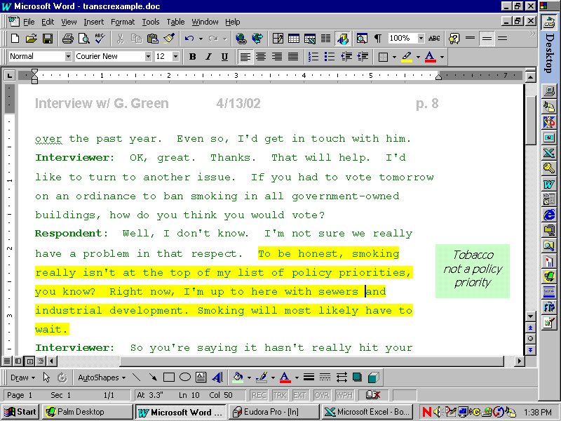
If you’ve entered your data into a word processing file, you might highlight quotes and type category labels in the margins. It is a good idea to leave a wide margin when you create the file so you have space to type in the margins.

Slide 49
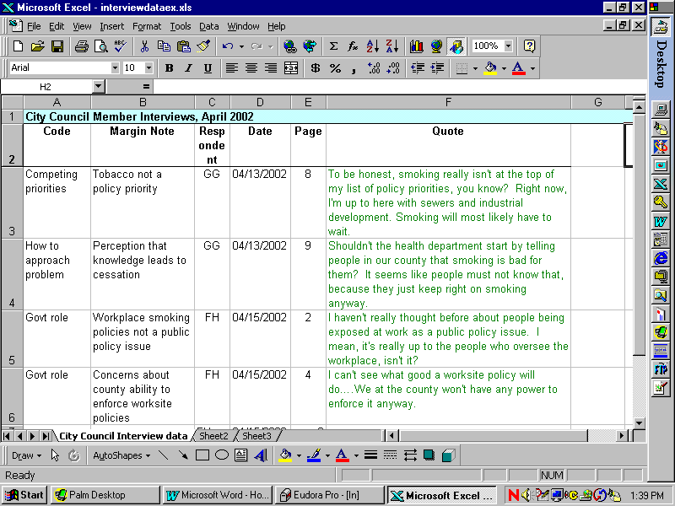
Or, you might use Excel to organize and categorize your data
Example data set

Slide 50
Step 4. Identify patterns within and between categories
Once you have identified the categories, you might:
  Sort and assemble all data by theme
  Sort and assemble data into larger categories
  Count the number of times certain themes arise to show relative importance (not suitable for statistical analysis)
  Show relationships among categories

Slide 51

Working with others (key stakeholders, other program staff, participants) in the coding and interpretation process is helpful. For example, several people might review the data independently to identify categories. Then, you can compare categories and resolve any discrepancies.
How else might you involve others in your qualitative data analysis?

Slide 52
Step 5. Interpretation
Now, stand back and think about what you’ve learned. What do these categories and patterns mean? What is really important?
  -What did you learn?

Slide 53

Congratulations!
Learning how to analyze qualitative data is a rich and rewarding experience. The more you practice, the easier it will become.
Have fun!!
Let us practice a data analysis!!!

Slide 54
Chapter 5: The Results Section
The results section should start with descriptive (summary).
A summary table of descriptive statistics can be provided – only display information once and in one format (e.g. Written on table or chart).
Use graphs where meaningful but ensure axis are consistent, graphs and axis are titled and the graph means something to the overall report.
Report the statistical tests used in the study.

Slide 55
The results are actual statements of observations, including statistics, tables and graphs.
Mention negative results as well as positive. Do not interpret results - save that for the discussion.
Lay out the case as for a jury. Present sufficient details so that others can draw their own inferences and construct their own explanations and understandings.
Compare the results to other sources (previous studies).
Break up your results into logical segments by using sub-headings
Key results should be stated in clear sentences at the beginning of paragraphs.
Weave all shreds to make a beautiful story.

Slide 56
Chapter 6: Findings Discussion
This chapter is to discuss implications arising from the findings.
It is not just to summarize issues or themes arising from the previous chapters. The writer must do something with the findings of the research to advance the central argument of the thesis, often using further literature to support the findings or to refute previous studies.
It adds meaning to information by making connections and comparisons and exploring causes and consequences

Slide 57
Discussion
The discussion enables the interpretation and explanation of the study results.
The main purpose is to discuss implications arising from the study.
Results should be related back to research studies discussed in the introduction.
The discussion outlines any limitations with the current study and provides a rationale for future studies.
Sometimes, recommendations are given in this chapter.

Slide 58
Conclusion
- Evidence of your scholarship must be available for the examiner/ reader
Summarize your experience of the research training you have undertaken culminating in the thesis.
Demonstrate your flexibility, your ability to critique your own work.
The discussion should contain ideas for where future work might be needed or directed.

Slide 59

References
Harvard (or APA) style
Appendices

